Slide 1
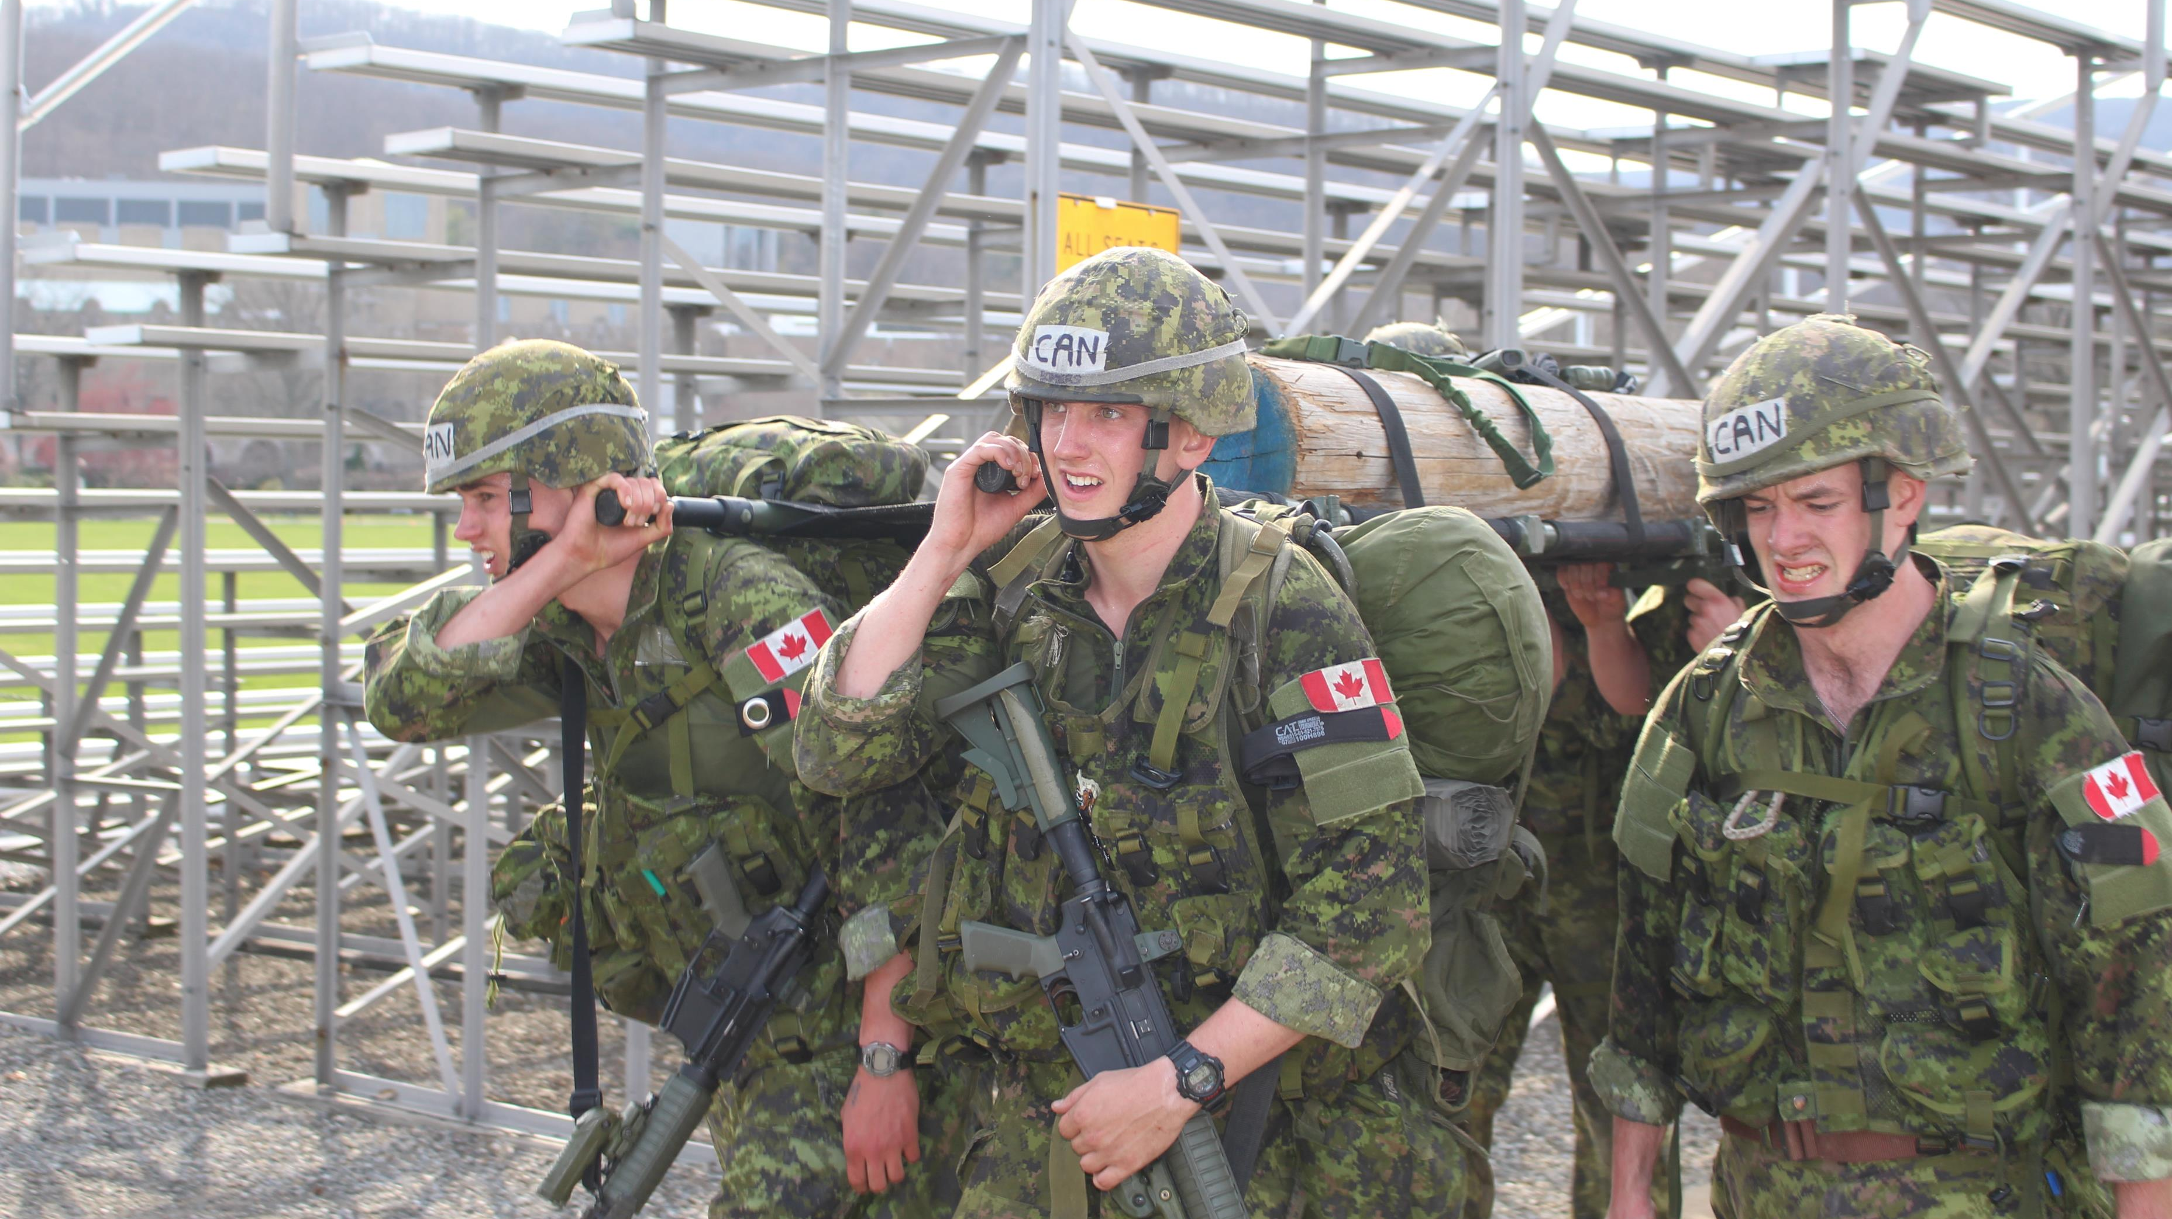
Introductory meeting
2018/2019 équipe de compétences militaires

Slide 2
Video
https://www.youtube.com/watch?v=_LuItfPQ7ng

Slide 3
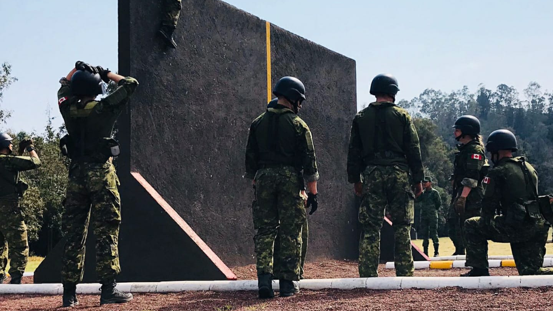
OVERVIEW
Goals and objectives
Monthly schedule
Who are we?
Competitions
Tryouts
Questions
Buts et objectifs
Calendrier mensuel
Qui sommes nous?
Compétitions
Sélections
Questions

Slide 4
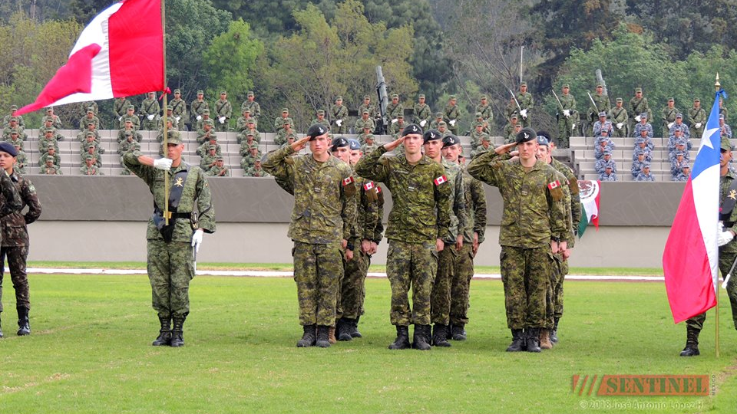
OBJECTIFS POUR CETTE année
année
1st USA Sandhurst
1st Mexico Chimaltalli

Slide 5
OBJECTIFS POUR MOI (IC)
Ensure that each and every person enjoys being part of the team.
Develop ourselves to become better people and better leaders.
M’assurez que chaque personne aime faire partis de l'équipe..
Se développer pour devenir de meilleures personnes et de meilleurs leaders.

Slide 6
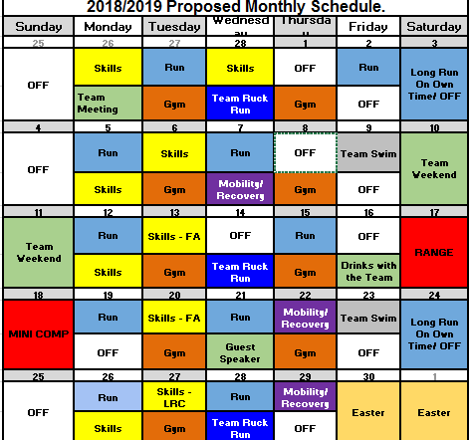
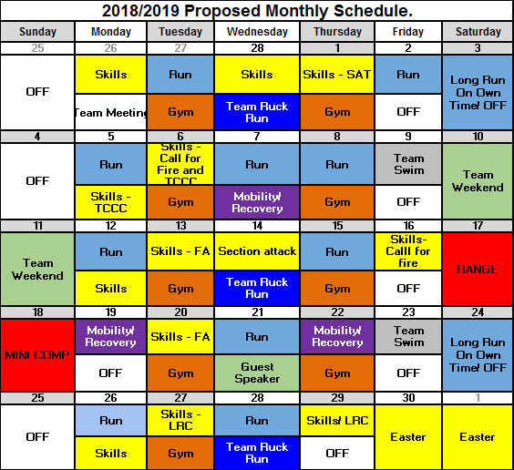

Slide 7
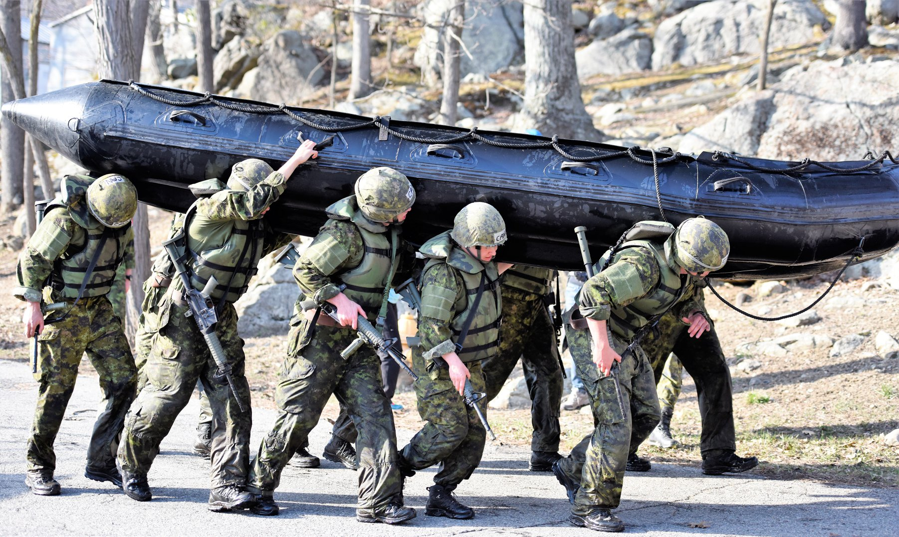
Too much of a commitment?
Pas assez de temps?

Slide 8
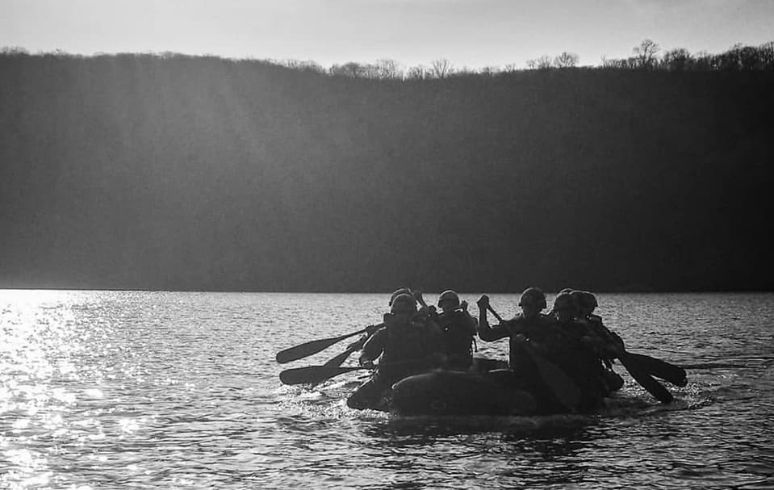
Gym Sessions
Created by Tomasz/ Coordonné par Tomasz
Not afraid to cancel sessions if we need to/ Pas peur d’annuler des sessions
Working on physio therapist. (Military or Civilian)
physiothérapeute. (Militaire ou civil)

Slide 9
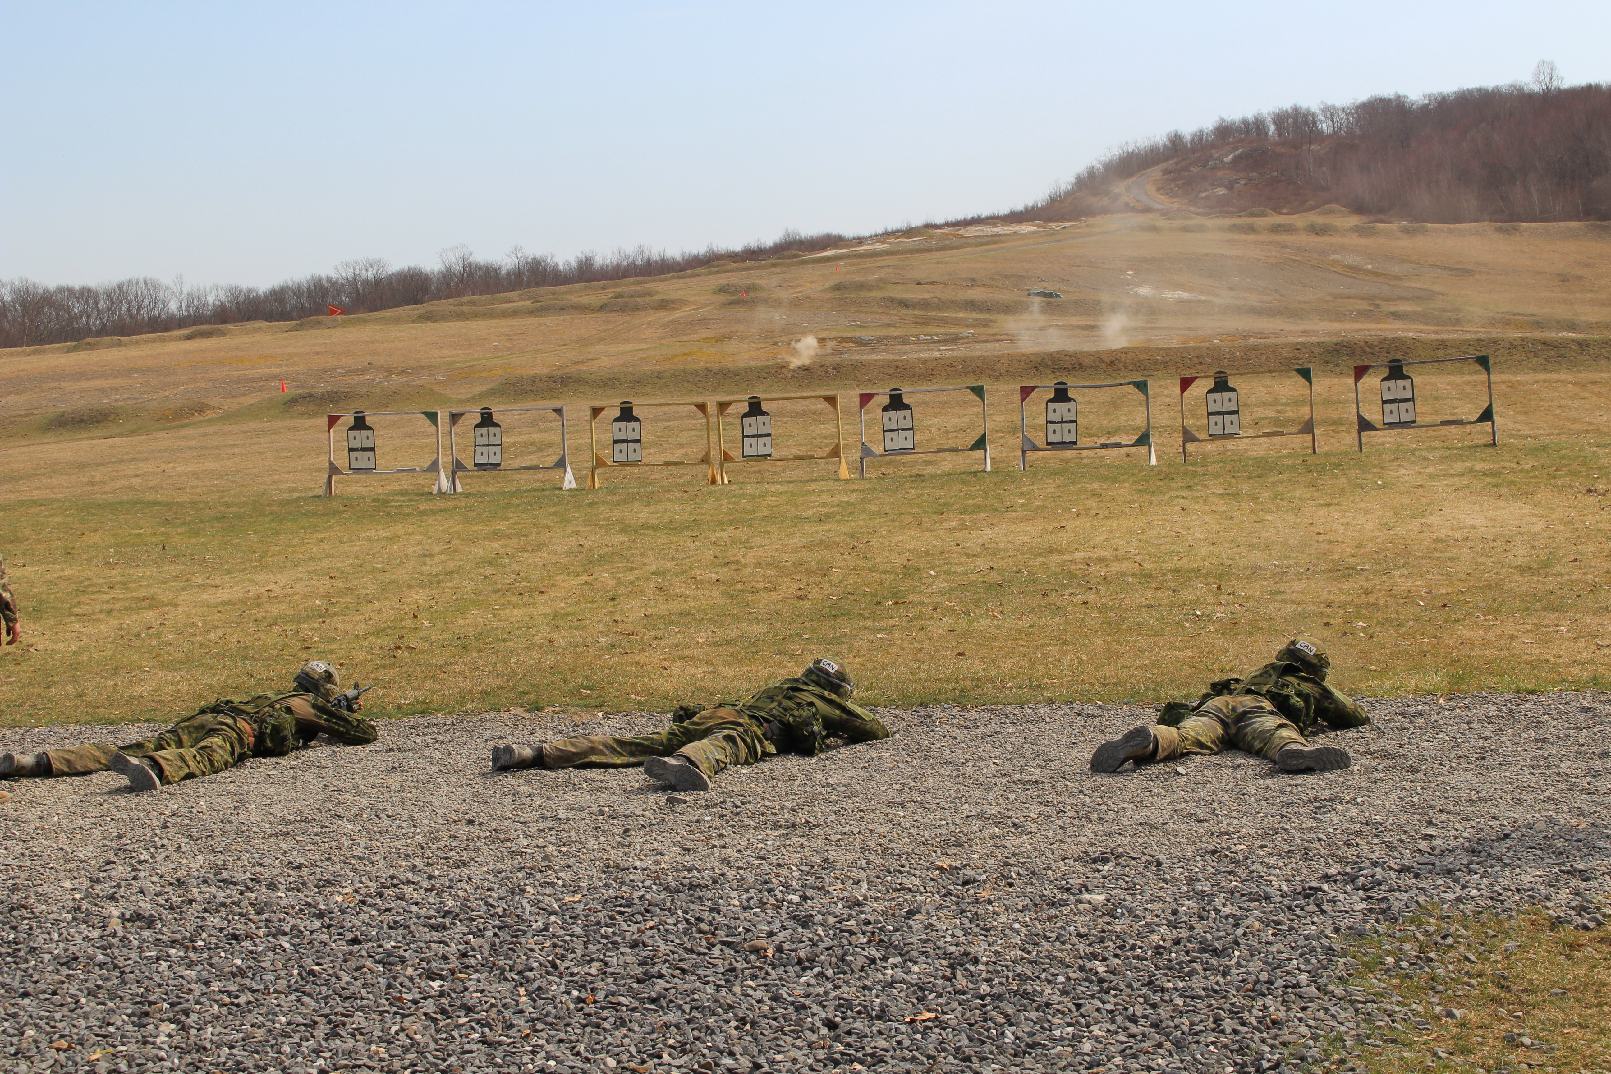
Team shoots
Coordinated by Sgt/Coordonné par Sgt
Stress shoots/ Tir de stress
Weekday shoots?/ Tir pendant la semaine?

Slide 10
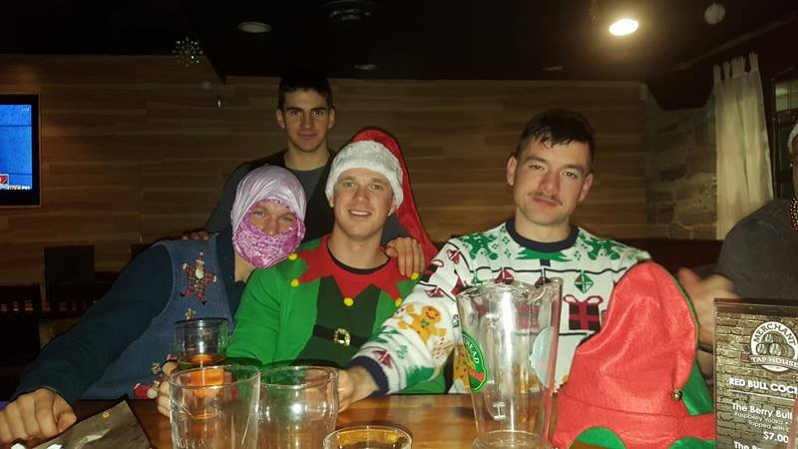
Team events
Intent: To develop our military and leadership capabilities/ Intention: Développer nos capacités militaires et de leadership
Emphasis on creating a family/ Accent sur la création d'une famille
Why are you deciding to try out for the team?
Pourquoi décidez-vous d'essayer pour l'équipe?
Notes:
Mountain camping
Tough mudder type
Visit CANSOFCOM?
Fun, train, leadership development

Slide 11
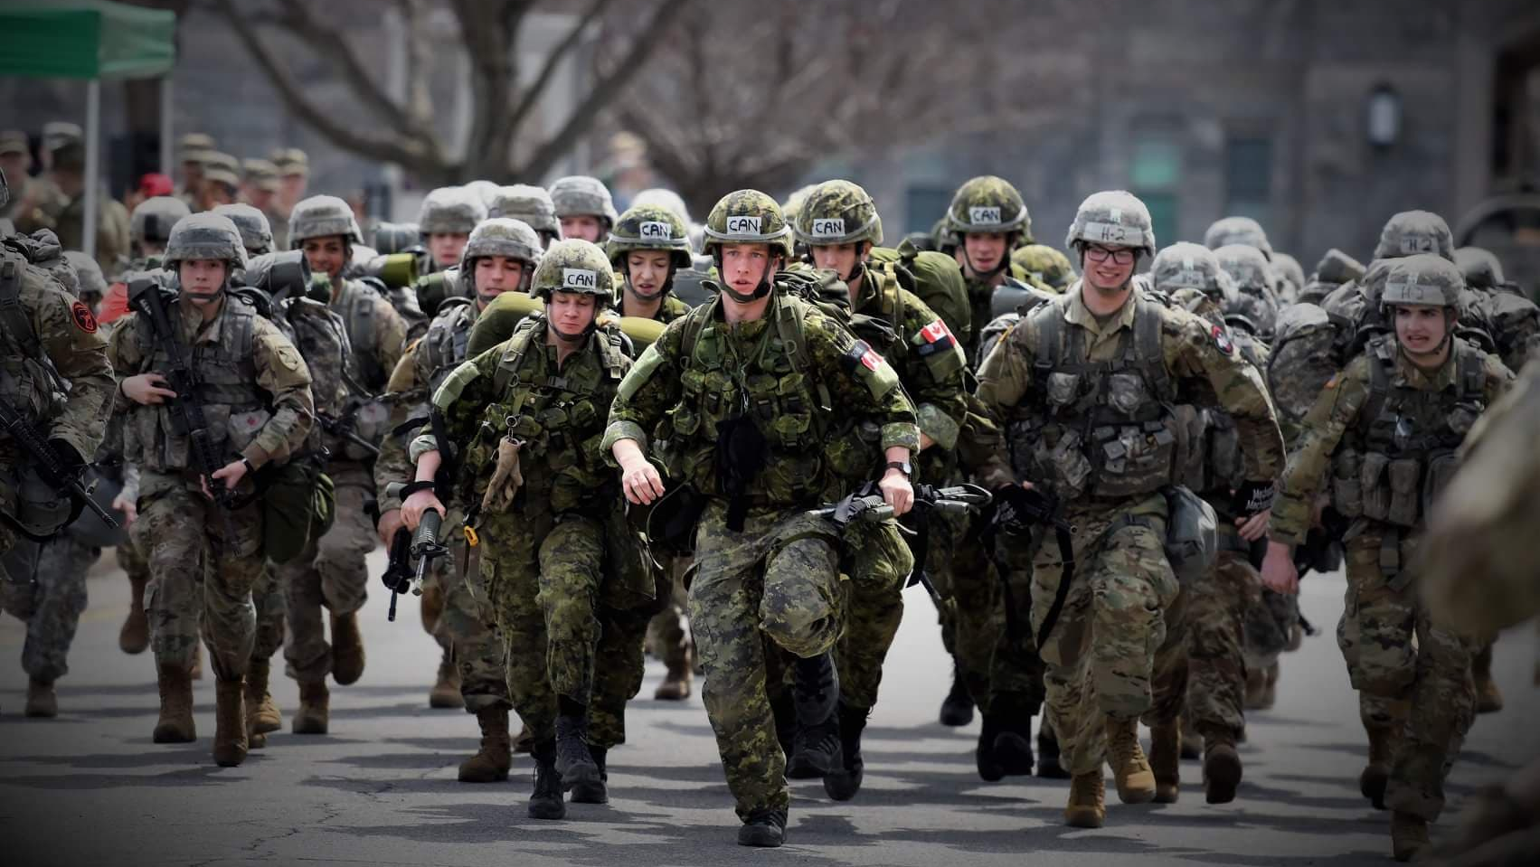
Who are we?
Qui Sommes Nous?

Slide 12
Qui SOMMES NOUS?
Selfless- Sword before self. Your team expects you to put others before yourself. We are a cohesive unit and will stand by each other no matter the circumstance.
Excellence- We are what we repeatedly do. We aim for perfection and hold each other accountable through our efforts.

Slide 13
Qui sommes nous?
Resilient- Stay in the fight. When we need a hand we ask our brothers and sisters without hesitation. We push ourselves every day for our own personal development and for the benefit of the team.
Competitive- Why are we here? We strive for success, give 100% in everything we do, and never give up on ourselves or each other.

Slide 14
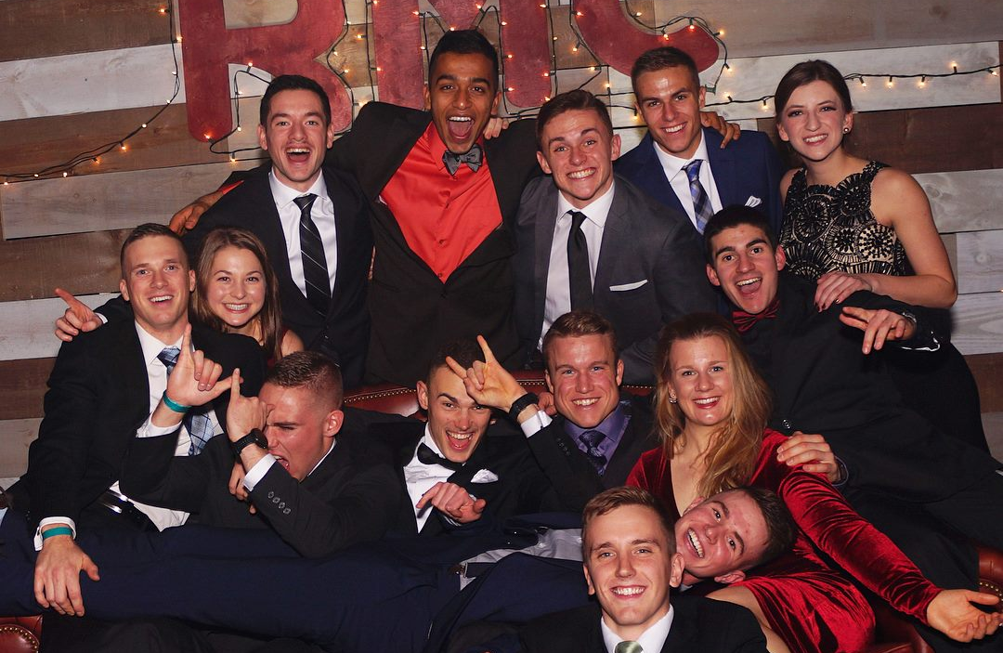
mon expérience

Slide 15
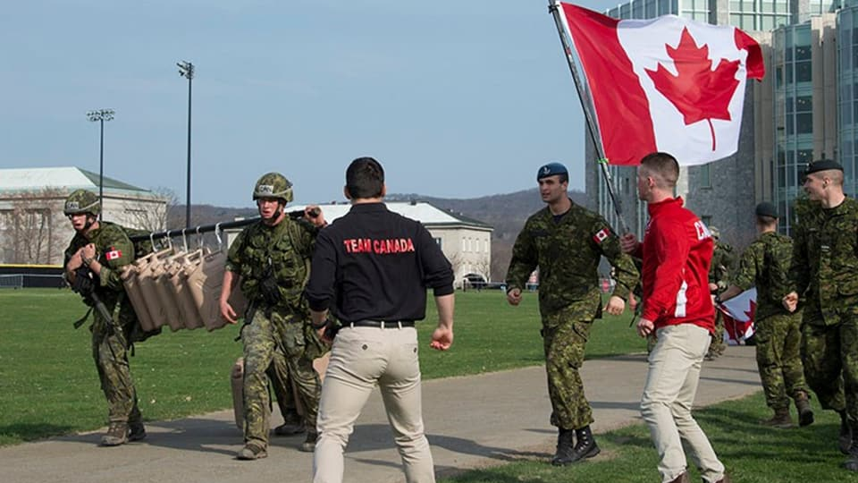
West point “Sandhurst”

Slide 16
Video
https://www.youtube.com/watch?v=P34x7Wzs960

Slide 17
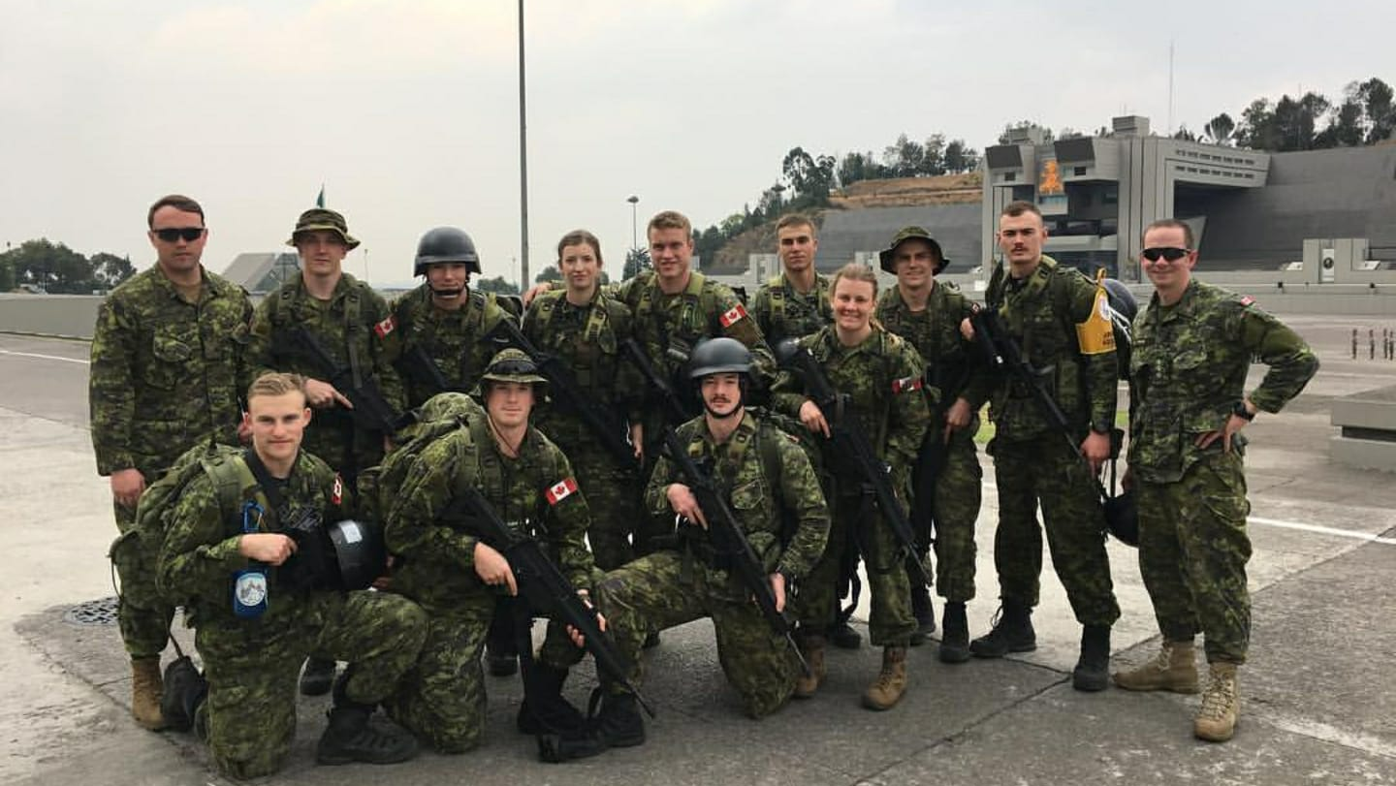
Mexico “Chimaltalli”

Slide 18
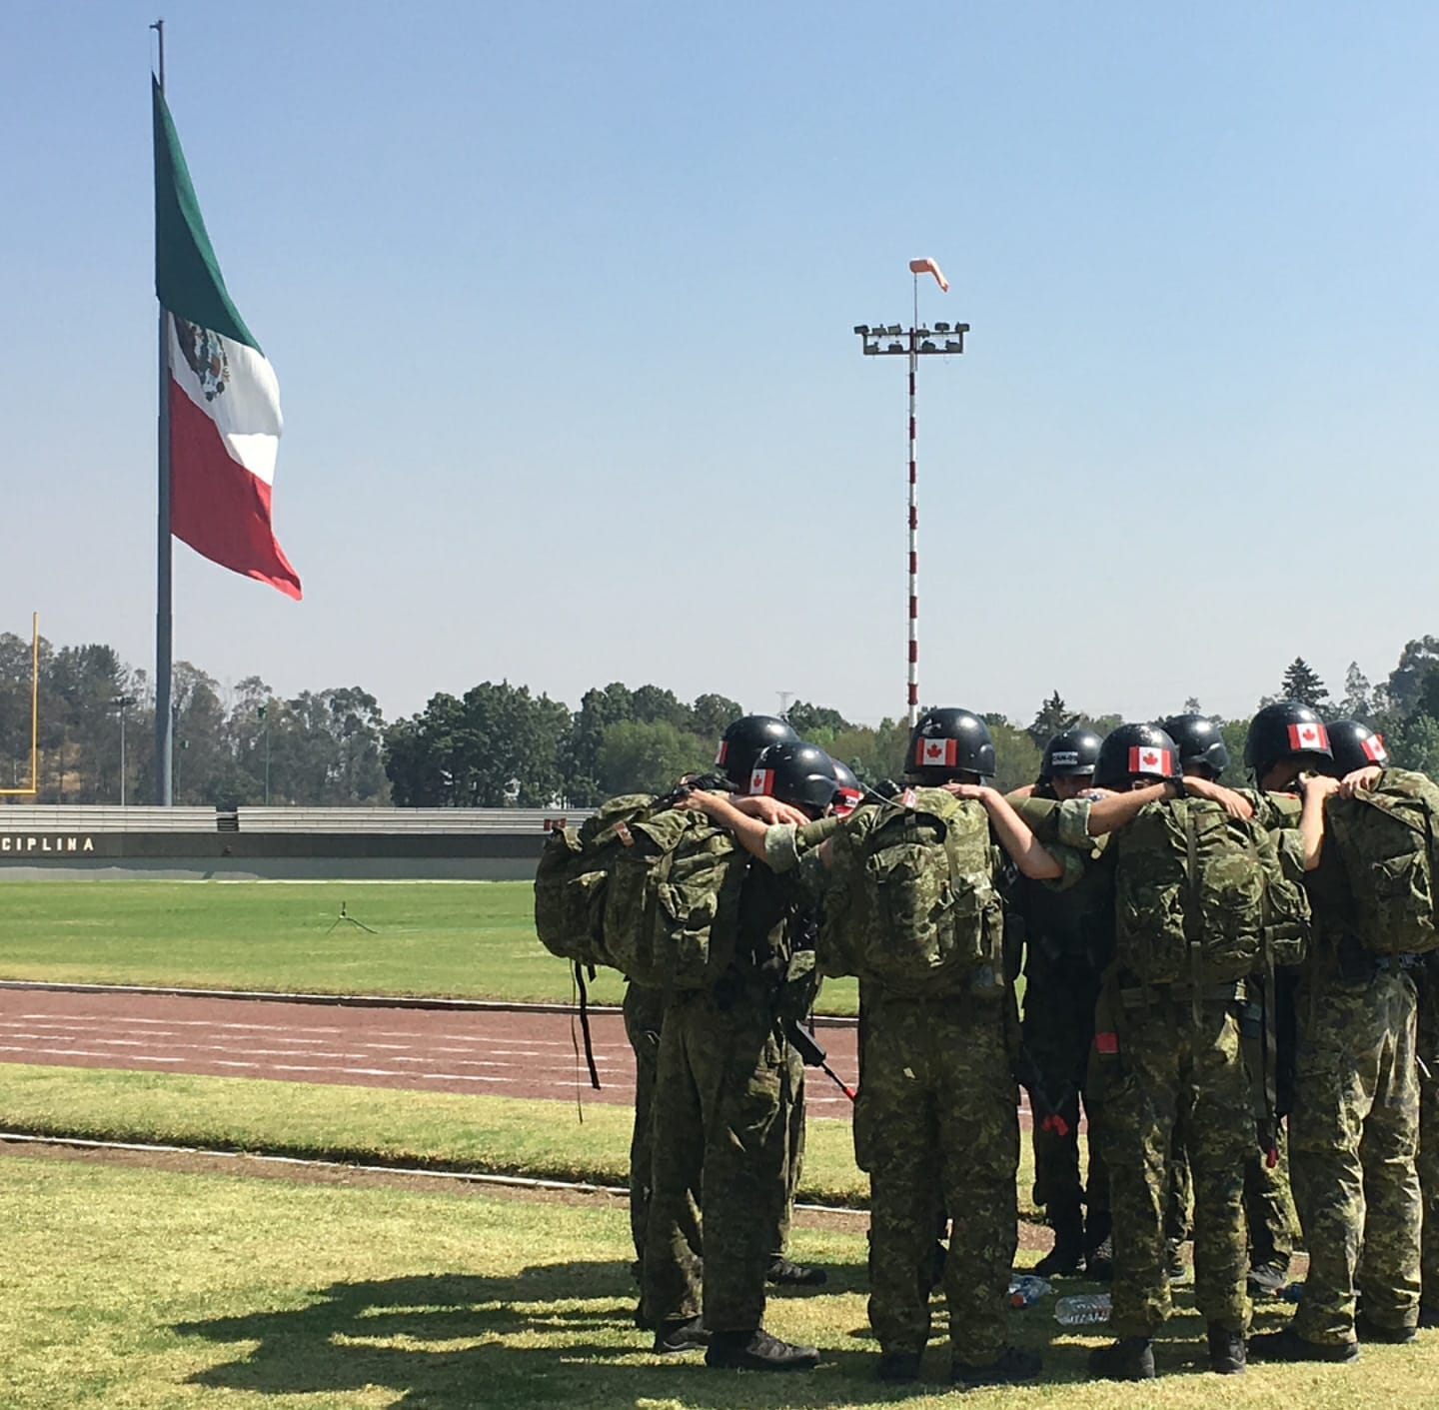
Represent Your Country Internationally
Sept 24th to 28th
^{Military Skills Team}

Slide 19
TRYOUTS
Leadership council will not be participating. WHY NOT?
Similar to last years tryout (swimming, running, weights)
Performance versus character evaluations
Conseil de leadership ne participera pas. POURQUOI PAS?
Similaire aux sélections de l'an dernier (natation, course à pied, poids)
Évaluation de performance vs personnalité

Slide 20
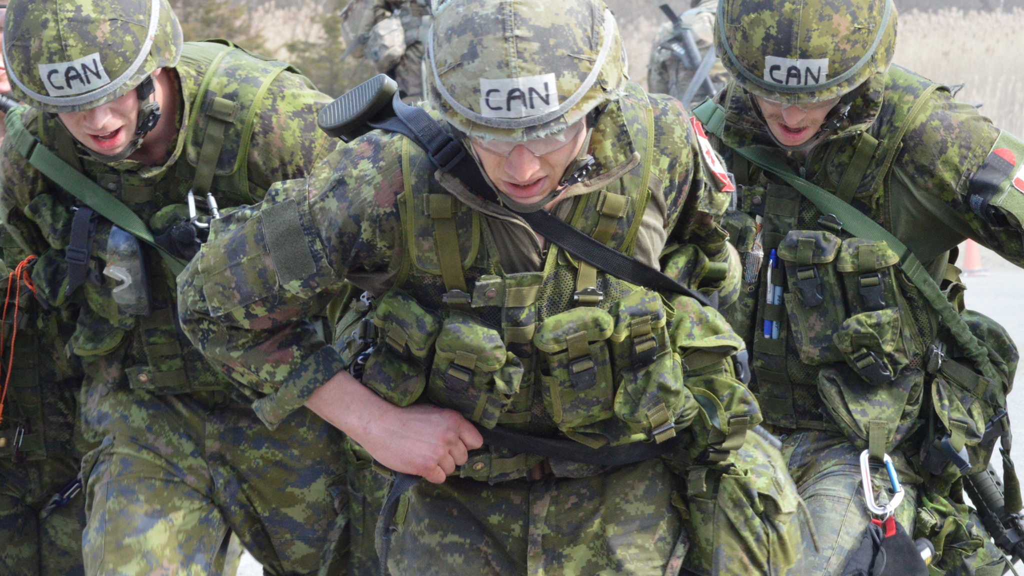
espérance
Mes Attentes de Vous
Show up mentally and physically prepared
Lead by example
Motivate and inspire
Be smart
Se présenter mentalement et physiquement préparé
Mener par l'exemple
Motiver et inspirer
Soyez intelligent

Slide 21
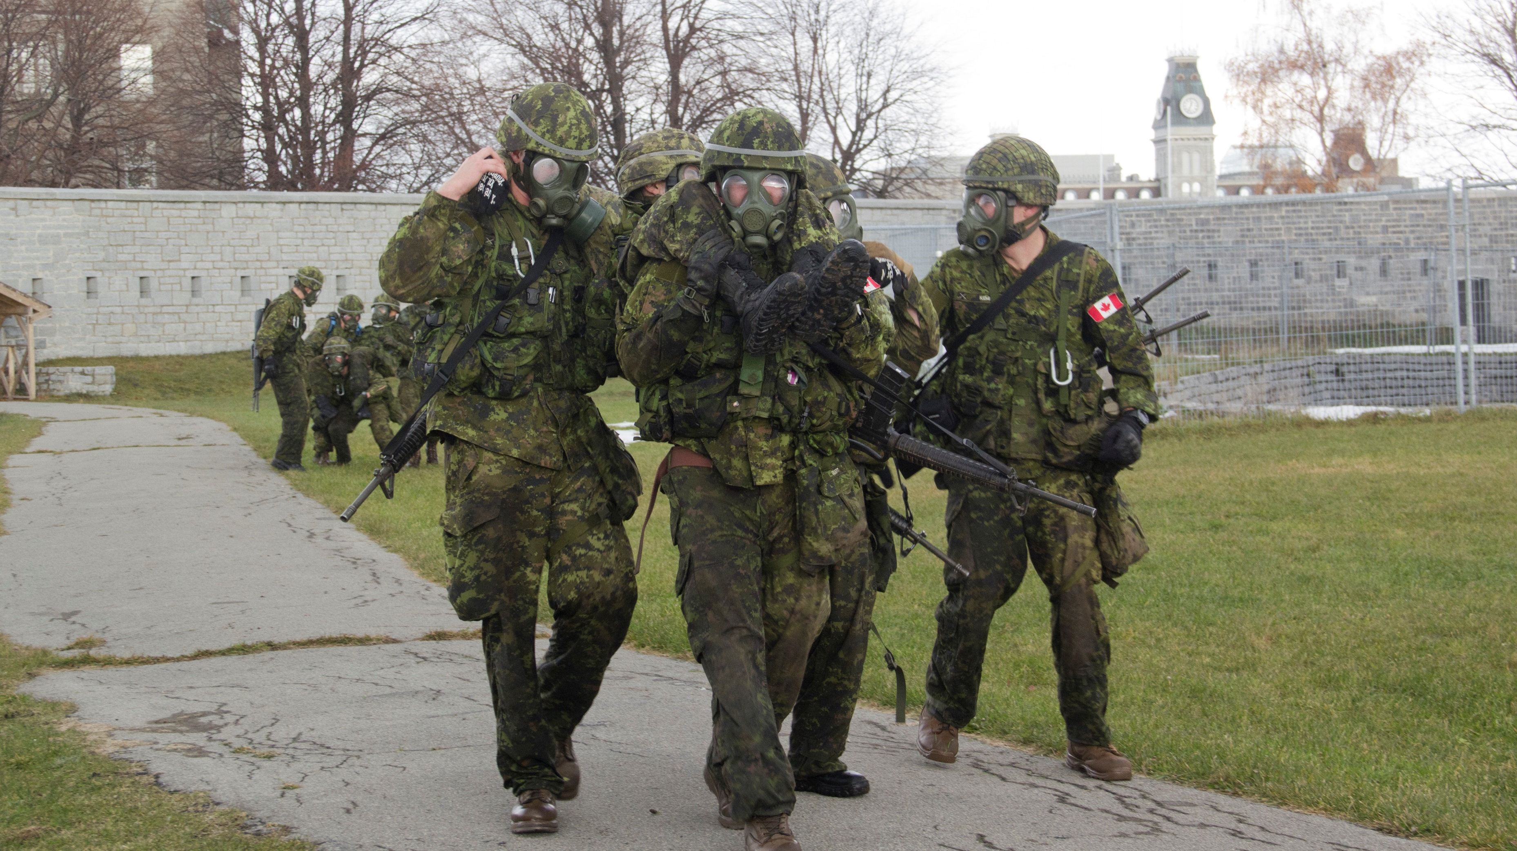
Military skills (im)
10 Sept @17:00

Slide 22
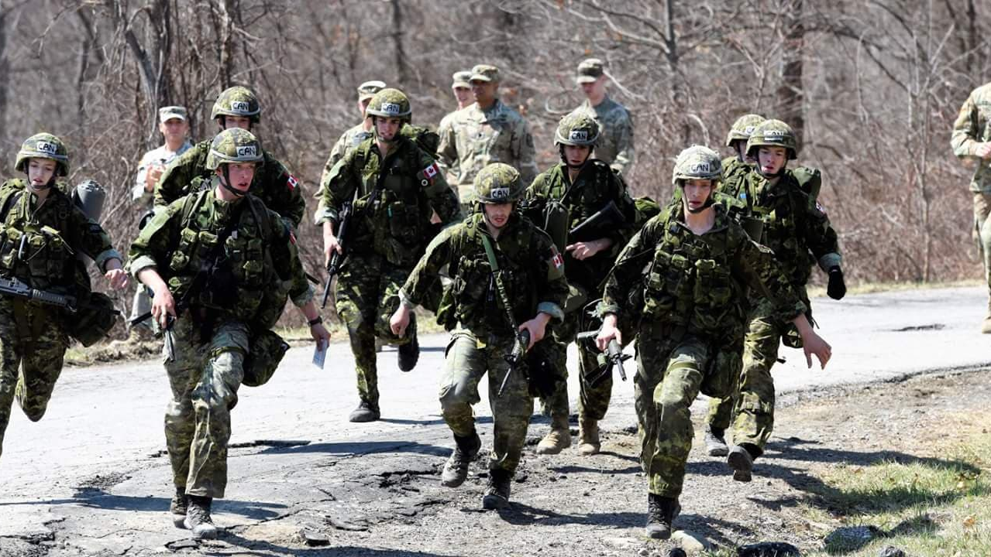
Questions?

